Slide 1
HTML - Forms

Slide 2
HTML Forms are required, when you want to collect some data from the site visitor. For example, during user registration you would like to collect information such as name, email address, credit card, etc.
A form will take input from the site visitor and then will post it to a back-end application.
There are various form elements available like text fields, textarea fields, drop-down menus, radio buttons, checkboxes, etc.
The HTML <form> tag is used to create an HTML.

Slide 3
HTML Form Controls
There are different types of form controls that you can use to collect data using HTML form −
Text Input Controls
Checkboxes Controls
Radio Box Controls
Select Box Controls
File Select boxes
Hidden Controls
Clickable Buttons
Submit and Reset Button

Slide 4
Text Input Controls
There are three types of text input used on forms −
Single-line text input controls − This control is used for items that require only one line of user input, such as search boxes or names. They are created using HTML <input> tag.
Password input controls − This is also a single-line text input but it masks the character as soon as a user enters it. They are also created using HTMl <input> tag.
Multi-line text input controls − This is used when the user is required to give details that may be longer than a single sentence. Multi-line input controls are created using HTML <textarea> tag.

Slide 5
Single-line text input controls
This control is used for items that require only one line of user input, such as search boxes or names. They are created using HTML <input> tag.
Example
Here is a basic example of a single-line text input used to take first name and last name −
<body>
<form >
First name: <input type = "text" name = "first_name" /> <br>
Last name: <input type = "text" name = "last_name" /> </form>
</body>

Slide 6
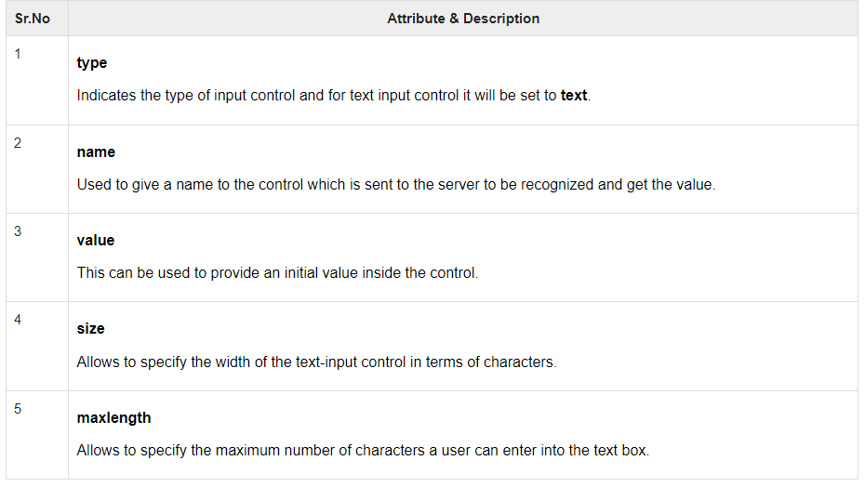
Attributes
Following is the list of attributes for <input> tag for creating text field.

Slide 7
Password input controls
This is also a single-line text input but it masks the character as soon as a user enters it. They are also created using HTML <input>tag but type attribute is set to password.
Example
Here is a basic example of a single-line password input used to take user password −
<body>
<form >
User ID : <input type = "text" name = "user_id" /> <br>
Password: <input type = "password" name = "password" />
</form>
</body>

Slide 8
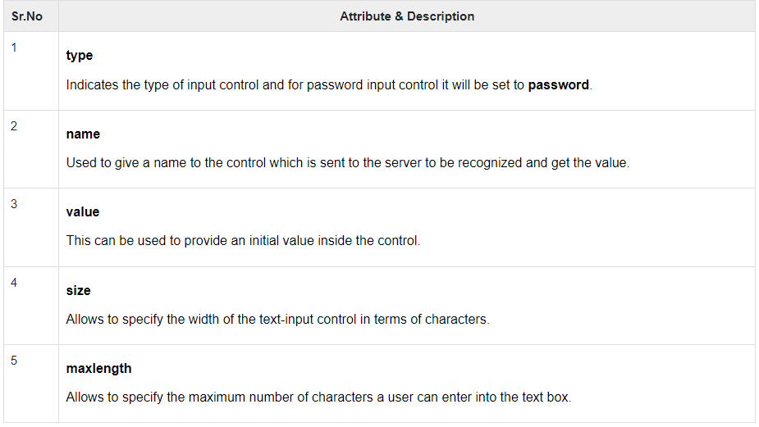
Attributes
Following is the list of attributes for <input> tag for creating text field.

Slide 9
Multiple-Line Text Input Controls
This is used when the user is required to give details that may be longer than a single sentence. Multi-line input controls are created using HTML <textarea> tag.
Example
Here is a basic example of a multi-line text input used to take item description −
<body>
<form>
Description : <br /> <textarea rows = "5" cols = "50" name = "description">
Enter description here... </textarea>
</form>
</body>

Slide 10
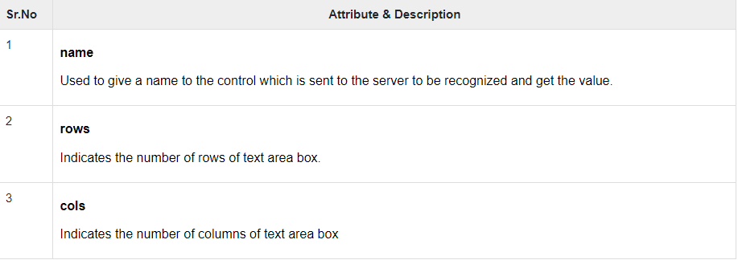
Attributes
Following is the list of attributes for <textarea> tag.

Slide 11
Checkbox Control
Checkboxes are used when more than one option is required to be selected. They are also created using HTML <input> tag but type attribute is set to checkbox..
Example
Here is an example HTML code for a form with two checkboxes −
<body>
<form>
<input type = "checkbox" name = "maths" value = "on"> Maths
<input type = "checkbox" name = "physics" value = "on"> Physics
</form>
</body>

Slide 12
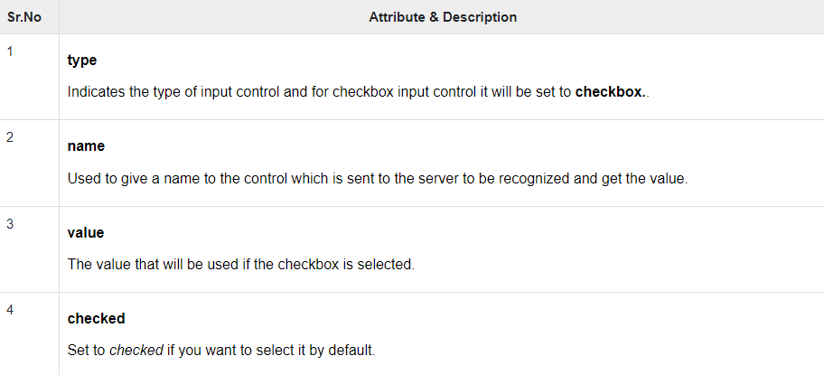
Attributes
Following is the list of attributes for <checkbox> tag.

Slide 13
Radio Button Control
Radio buttons are used when out of many options, just one option is required to be selected. They are also created using HTML <input> tag but type attribute is set to radio.
Example
Here is example HTML code for a form with two radio buttons −
<body>
<form>
<input type = "radio" name = "subject" value = "maths"> Maths
<input type = "radio" name = "subject" value = "physics"> Physics
</form>
</body>

Slide 14
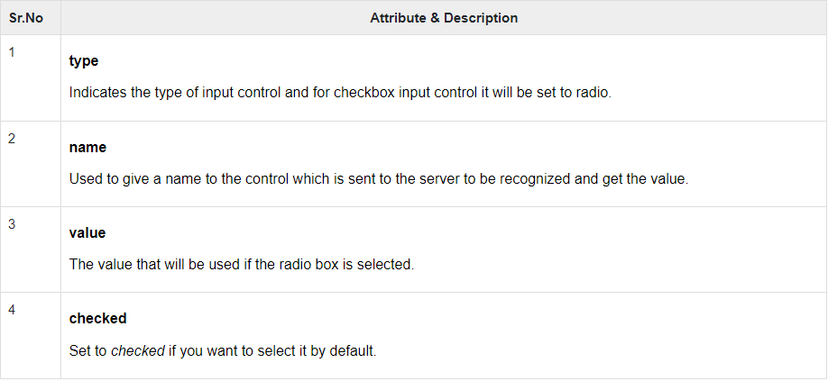
Attributes
Following is the list of attributes for radio button.

Slide 15
Select Box Control
A select box, also called drop down box which provides option to list down various options in the form of drop down list, from where a user can select one or more options.
Example
Here is example HTML code for a form with one drop down box
<body>
<form>
<select name = "dropdown">
<option value = "Maths" selected>Maths</option>
<option value = "Physics">Physics</option>
</select> </form> </body>

Slide 16
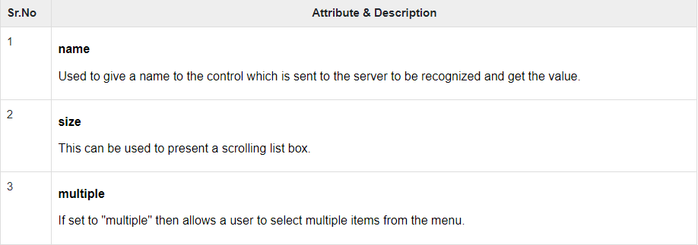
Attributes
Following is the list of important attributes of <select> tag −

Slide 17
File Upload Box
If you want to allow a user to upload a file to your web site, you will need to use a file upload box, also known as a file select box. This is also created using the <input> element but type attribute is set to file.
Example
Here is example HTML code for a form with one file upload box −
<body>
<form> <input type = "file" name = "fileupload" accept = "image/*" />
</form>
</body>

Slide 18
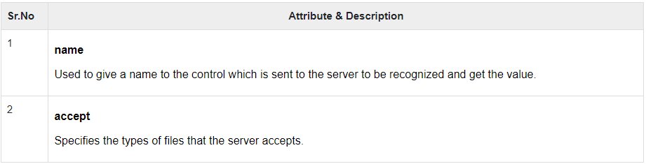
Attributes
Following is the list of important attributes of file upload box −

Slide 19
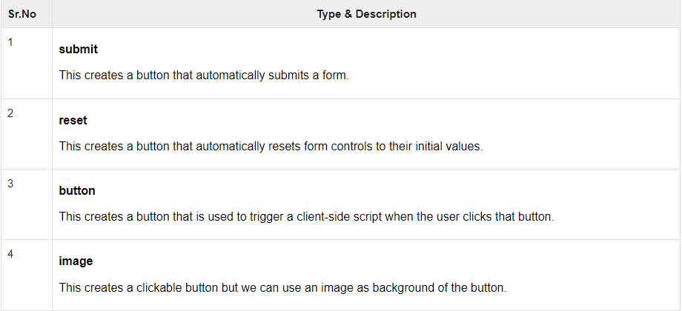
Button Controls
There are various ways in HTML to create clickable buttons. You can also create a clickable button using <input>tag by setting its type attribute to button. The type attribute can take the following values −

Slide 20
Button Controls
There are various ways in HTML to create clickable buttons. You can also create a clickable button using <input>tag by setting its type attribute to button. The type attribute can take the following values −

Slide 21
Example
Here is example HTML code for a form with three types of buttons −
<body>
<form>
<input type = "submit" name = "submit" value = "Submit" />
<input type = "reset" name = "reset" value = "Reset" />
<input type = "button" name = "ok" value = "OK" />
<input type = "image" name = "imagebutton" src = "/html/images/logo.png" />
</form>
</body>

Slide 22
Hidden Form Controls
Hidden form controls are used to hide data inside the page which later on can be pushed to the server. This control hides inside the code and does not appear on the actual page. For example, following hidden form is being used to keep current page number. When a user will click next page then the value of hidden control will be sent to the web server and there it will decide which page will be displayed next based on the passed current page.
Example
Here is example HTML code to show the usage of hidden control −
<body>
<form> <input type = "hidden" name = "pagename" value = "10" />
</form>
</body>

